Slide 1

Exploring Rideshare Usage Pattern using K- prototype segmentation analysis for the City of Chicago in the era of pandemic
CSCE 5063: MACHINE LEARNING
Project Update Presentation
PRESENTED BY
SHAKIL AHMED RAFI (010782622)
ARNA NISHITA NITHILA (010972702)

Slide 2

BACKGROUND OF THE STUDY
Ride-sharing (e.g. Uber, Lyft, and Didi) has a profound impact on travelers’ mobility pattern, transportation systems, and societies (Schaller, 2018; Alemi et al., 2018).
User clustering analysis helps to gain a deeper understanding of ride-sharing usage pattern in urban areas.
Only a handful of research focuses on ride-share user clustering; Soria et al. (2020) identified ride-sharing user segments using k-prototype segmentation analysis using ride-sourcing data, weather, transit, and taxi data.
The goal of the study is to detect ride-sharing user segments based on ride-share trips data, socio-economic (median income) and built-environment attributes (population density, employment density, number of transit stops available, land-use mix) using K-prototypes.
RIDE-
SHARE
USERS
CLUSTER
GOAL

Slide 3
METHODOLOGY
To examine patterns of ride-sharing usage, an unsupervised learning technique called K-prototypes will be used to cluster several observations together according to their attributes.
The advantage of using K-prototypes is its ability to accept categorical variables. The K-prototypes analysis will be used to find relationships in the ride-sharing data by grouping similar mixed (numerical and categorical) observations together.
The merging of multiple datasets further enabled the prototypes search to identify the main ride-sharing profiles with regards to trip attribute.
K-
Prototype
BENEFIT
Notes:
The objective function is defined as:
Where xj is a data point in the data set, Si is a cluster (set of data points and ui is the cluster mean(the center of cluster of Si)
K-Means Clustering Algorithm:
1. Choose a value of k, number of clusters to be formed.
2. Randomly select k data points from the data set as the intital cluster centeroids/centers
3. For each datapoint:
a. Compute the distance between the datapoint and the cluster centroid
b. Assign the datapoint to the closest centroid
4. For each cluster calculate the new mean based on the datapoints in the cluster.
5. Repeat 3 & 4 steps until mean of the clusters stops changing or maximum number of iterations reached.
https://medium.datadriveninvestor.com/k-means-clustering-b89d349e98e6

Slide 4
DATA AND SOURCE
Time Frame :July 01- July 31, 2020
Table 1: Variables used for ride-share users’ clustering for the City of Chicago
Category | Variables | Unit | Data Source
Trip Characteristics | Trip Count | Number | Chicago Data Portal
 | Trip Distance | Miles | Chicago Data Portal
 | Trip Duration | Seconds | Chicago Data Portal
Socio-Demographic Characteristics | Median Income | $ | American Community Survey
 | Median Age | Number | American Community Survey
Built Environment | Population Density | People/ acres | Smart Location Database
 | Employment density | Jobs/acres | Smart Location Database
 | Land-use mix | - | Smart Location Database
 | Percent of Zero Car Ownership | percentage | Smart Location Database
 | Distance from nearest transit stops | meters | Smart Location Database

Slide 5
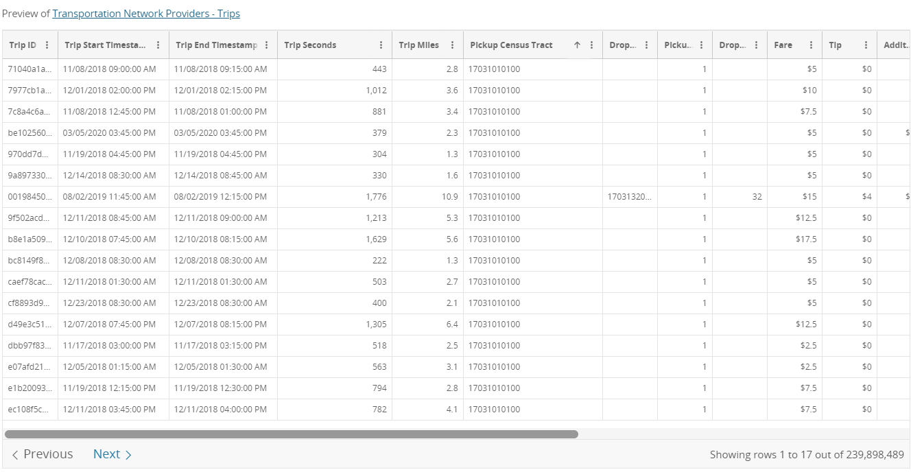
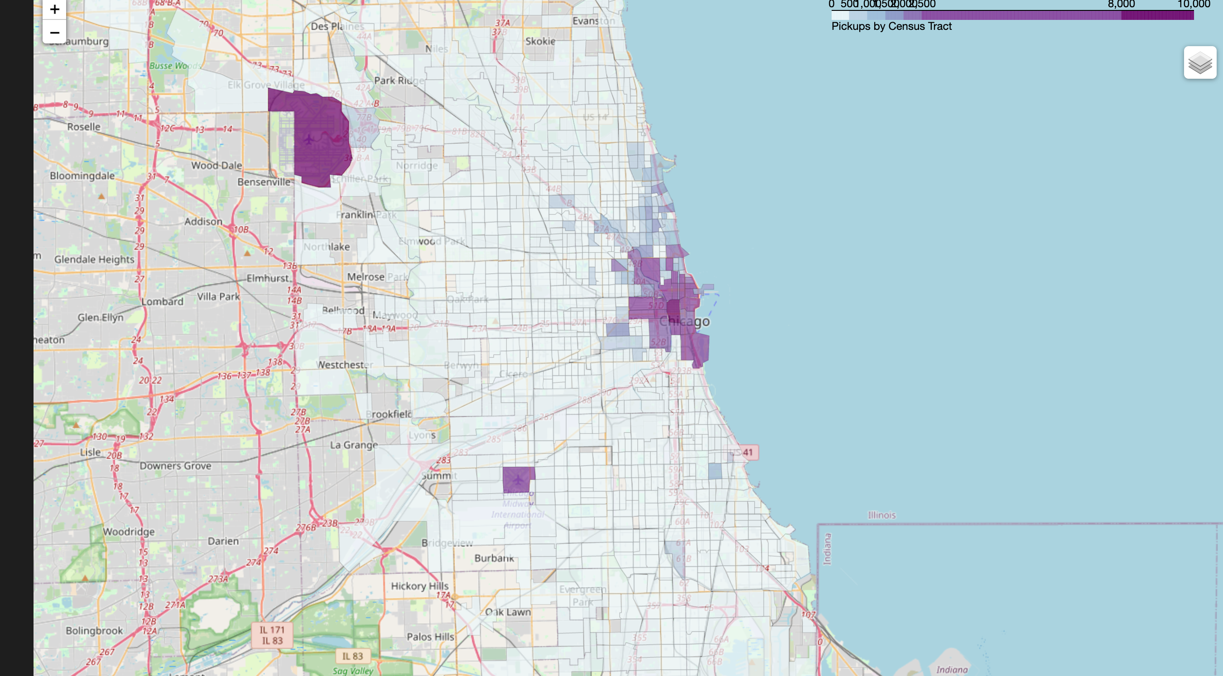
DATA AND SOURCE
PickUp Data Count
Data has a large variance.
The two airports ORD and MDW has high pickups.
https://data.cityofchicago.org/Transportation/Transportation-Network-Providers-Trips/m6dm-c72p/data
File Size: 801MB

Slide 6
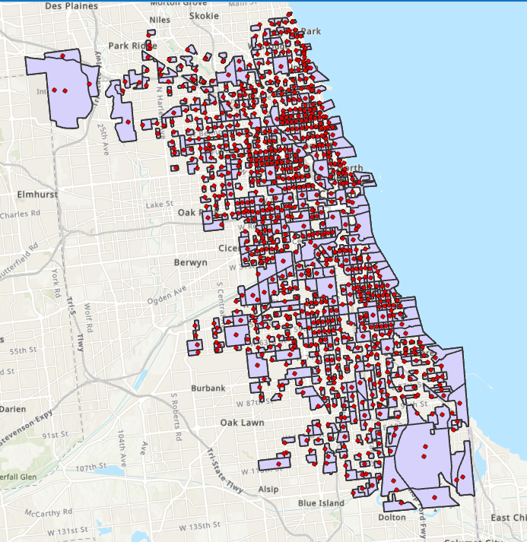
DATA AND SOURCE
PickUp Data Count
PICKUP DATA WAS AGGREGATED BASED ON THE CENSUS TRACT
SMART LOCATION DATABASE WAS FILTERED AGAINS PICKUP DATA
DUPLICATES WERE MERGED, NAN AND ZERO WAS THROWN OUT, PICKUP AND SMART LOCATION DATABASE WAS MERGED
PAIRPLOT AND DESCRIBE() WERE USED FOR EDA
WCSS ANALYSIS WAS DONE TO DETERMINE ELBOW
CLUSTERING WAS DONE WHERE THE ELBOW WAS.
https://data.cityofchicago.org/Transportation/Transportation-Network-Providers-Trips/m6dm-c72p/data
File Size: 801MB

Slide 7
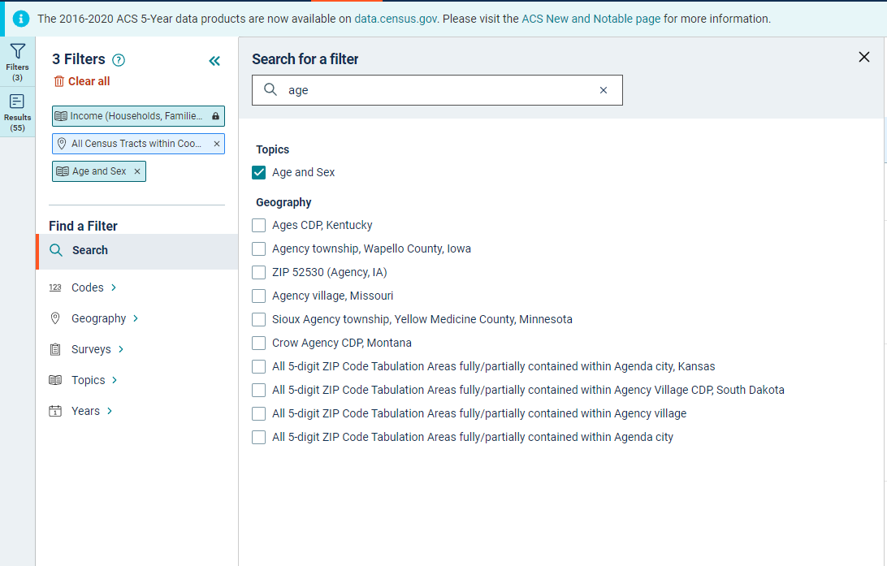
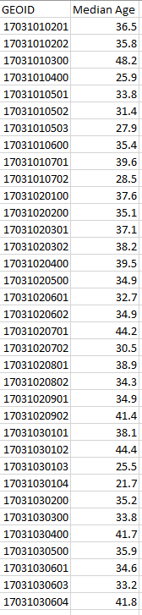
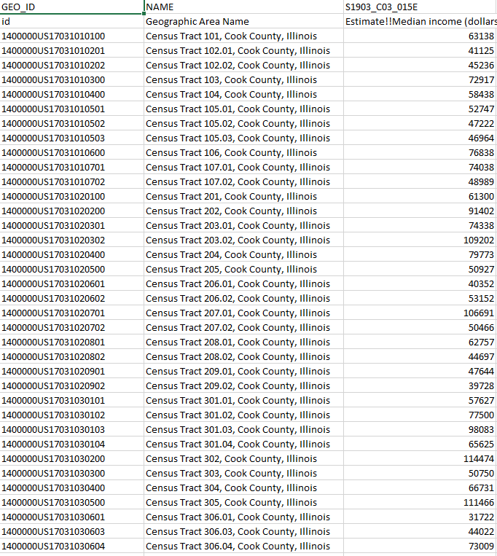
DATA AND SOURCE
Median Income and Age
https://data.census.gov/cedsci/table?q=income&t=Age%20and%20Sex&g=0500000US17031%241400000
File Size:3.6 MB

Slide 8
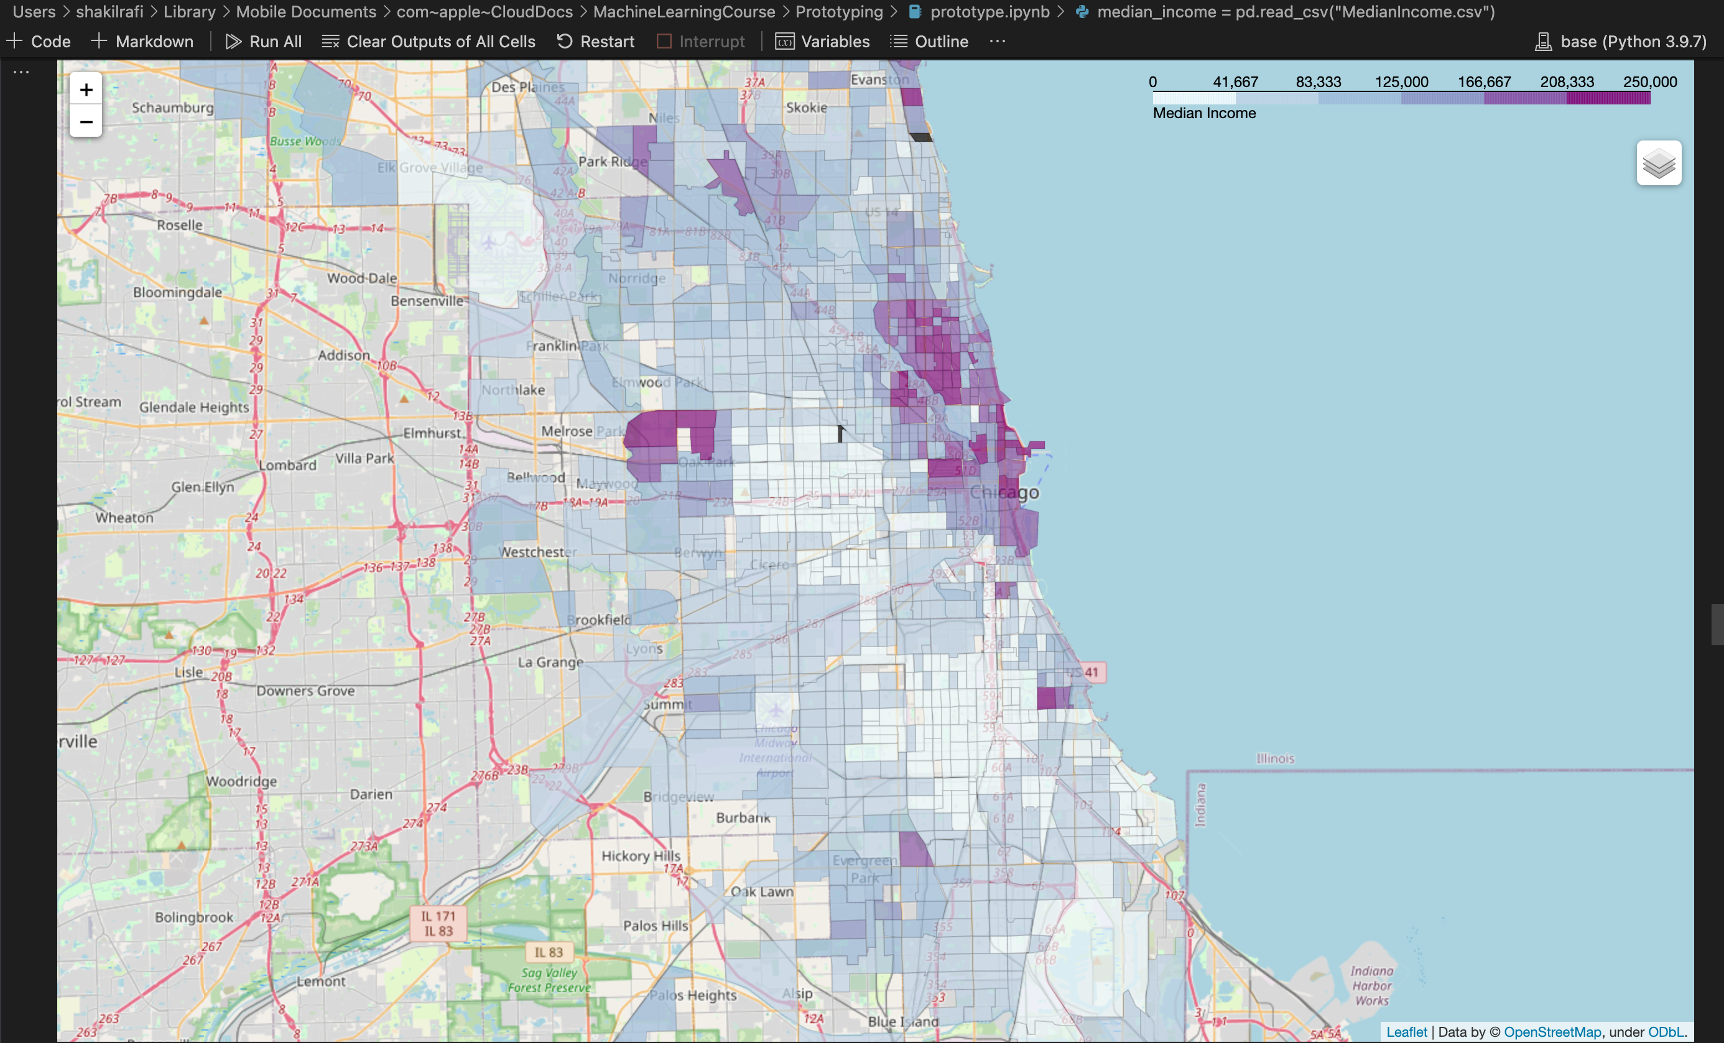
DATA AND SOURCE
Median Income map
Observations:
1. Most high median income individuals
reside near the town center near
Lake View and Wrigleyville
2. Pockets of high income exist in the
north
3. The airport census tract has NaN
Income, replaced by 0.

Slide 9
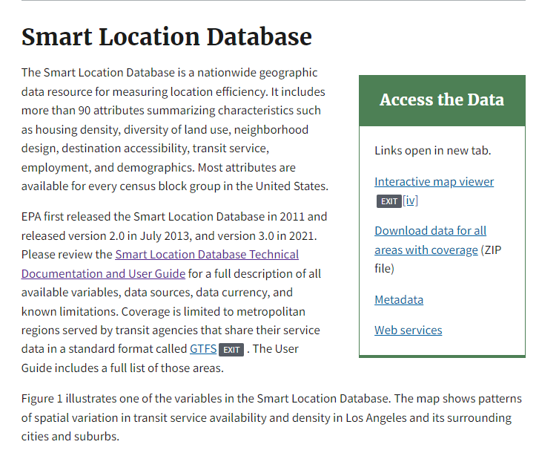
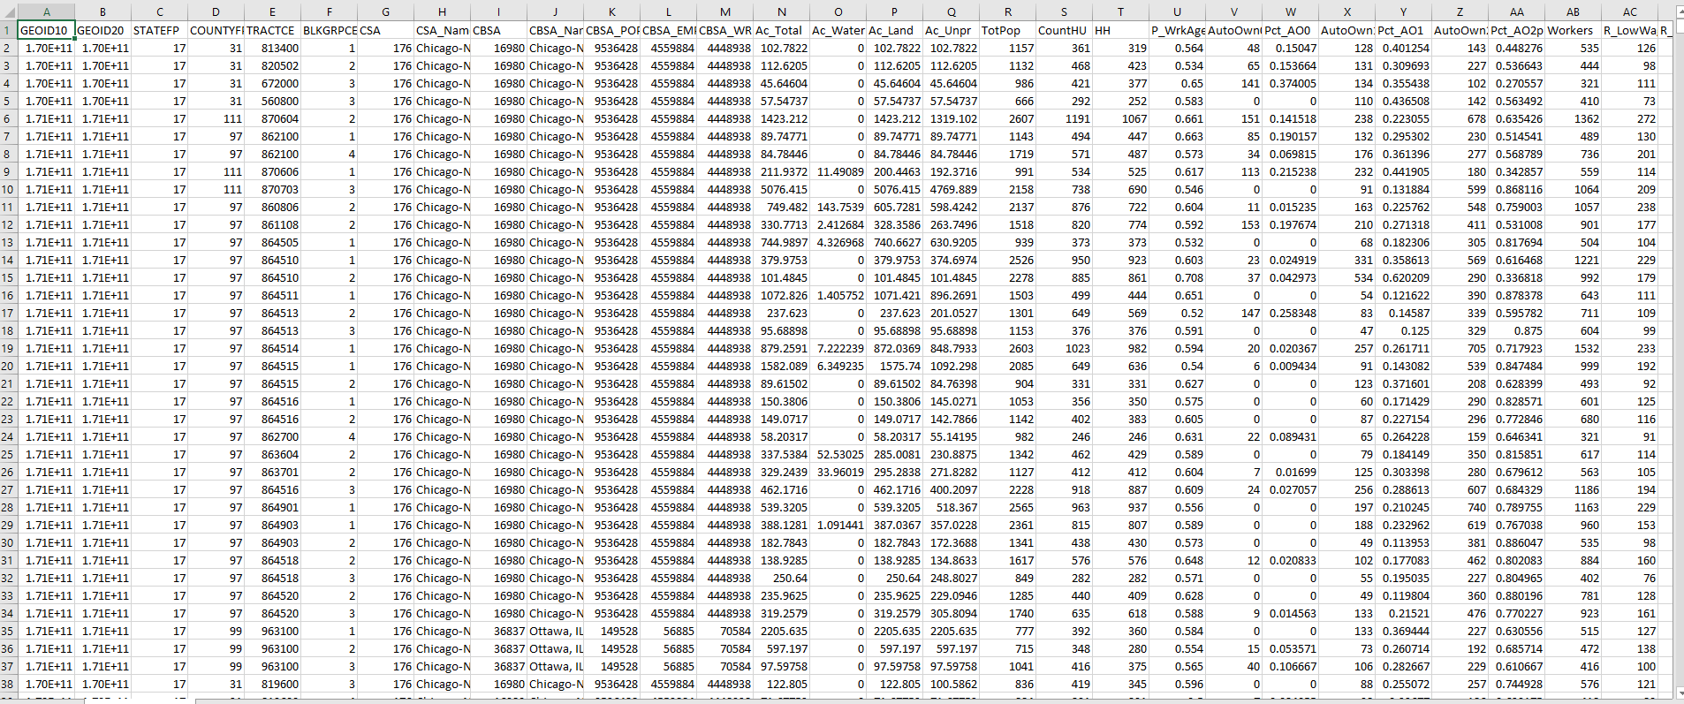
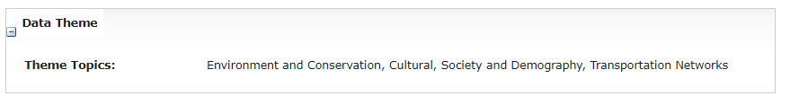
DATA AND SOURCE
Population Density
Employment Density
Percent of Zero Car Ownership
Land use Diversity
Distance from Transit
https://www.epa.gov/smartgrowth/smart-location-mapping
File Size:681 MB

Slide 10
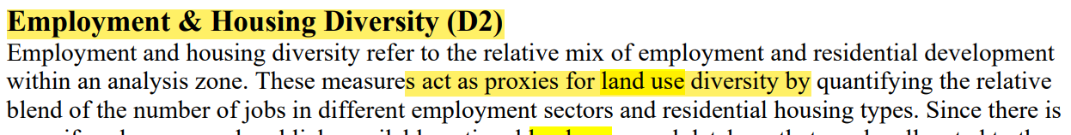
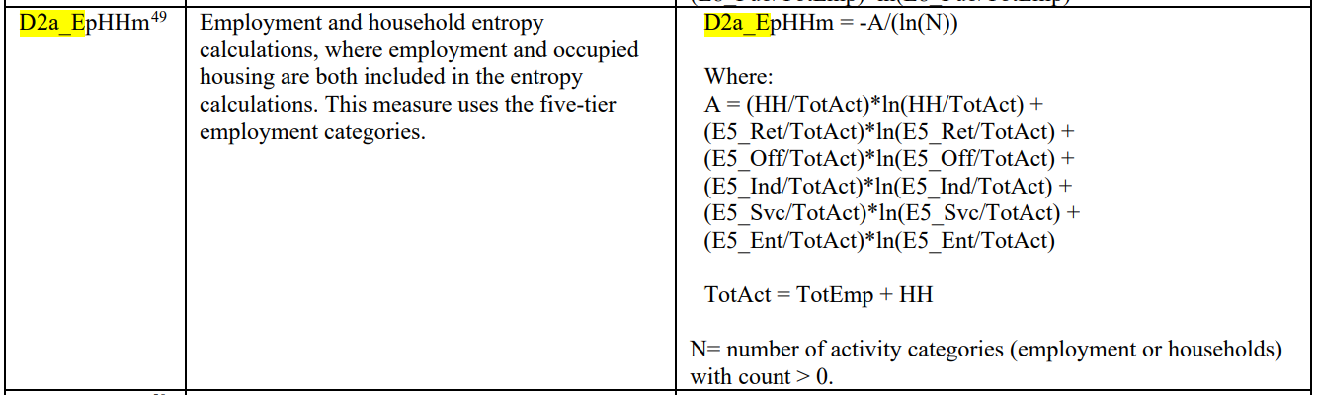
DATA AND SOURCE
Employment Density
LandUse Diversity
(https://www.epa.gov/smartgrowth/smart-location-database-technical-documentation-and-user-guide

Slide 11
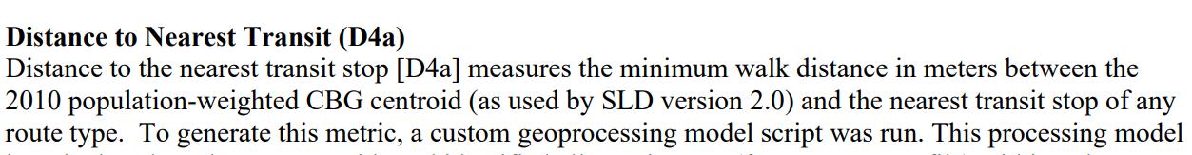
DATA AND SOURCE
Distance from Transit
(https://www.epa.gov/smartgrowth/smart-location-database-technical-documentation-and-user-guide

Slide 12
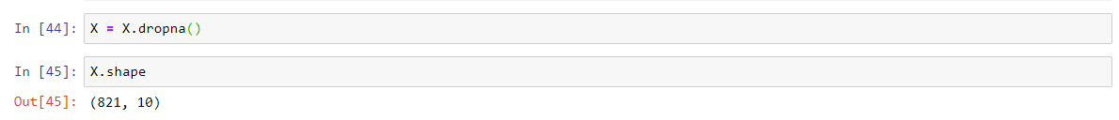
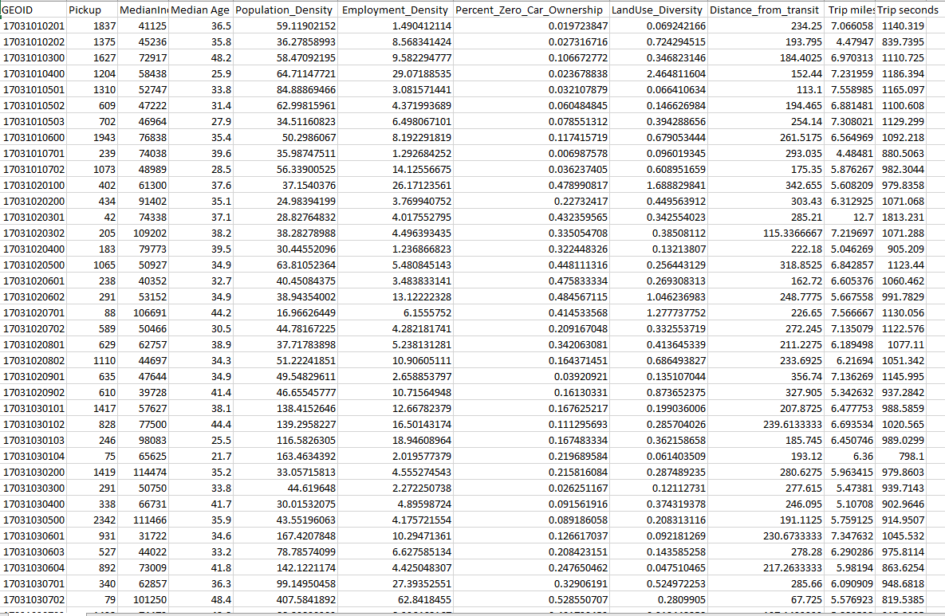
DATA AND SOURCE
Final Database
Download data as CSV from different sources and read it using Pandas
Dropping nulls values ( including population <=0, Distance from transit<0, Median Income <0, LanUse diversity <0)
Clean up data using dropna() and converting columns to the appropriate data types

Slide 13
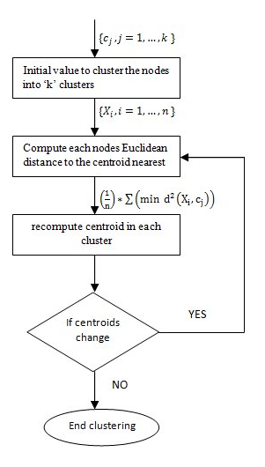


POTENTIAL FRAMEWORK
For handling data frames
Variables
Pandas
For fast numerical computations
and as the back-end to Pandas
Numpy
For its rich ecosystem of machine learning tools including K-means
Scikit-
Learn
data
https://medium.datadriveninvestor.com/k-means-clustering-b89d349e98e6

Slide 14
POTENTIAL FRAMEWORK
Download data as CSV from Chicago Data Portal and read it using Pandas
Clean up data using dropna() and converting columns to the appropriate data types
Conduct some exploratory data analysis to see where we are, including the describe() method and/or plotting some graphs.
Calculate error, subject to the error formula shown above, and already implemented in python libraries. This is a generalized version of WCSS
Run the test several times, tuning parameters until we get minimal error and documenting the output values at every turn
Obtain the result and document the entire step of the process and explain the process of experimentation.
Use visualization tools, e.g. matplotlib and folium to visualize the data
We are here

Slide 15
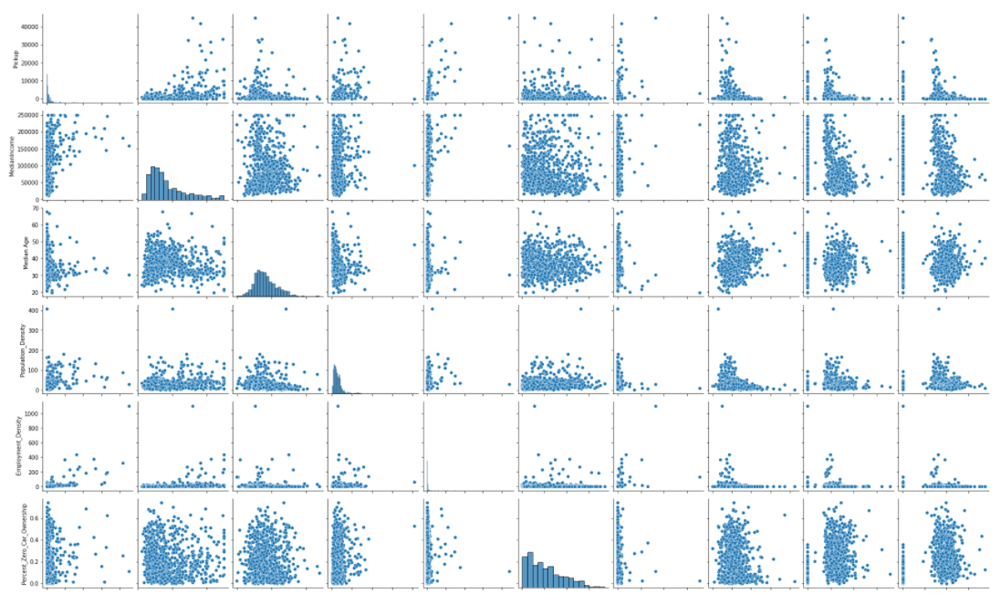
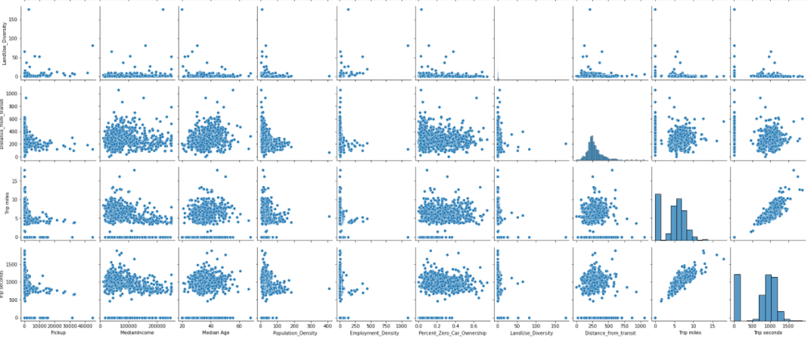
Output
Interesting observations:
1. Distance from transit is inversely correlated with
Number of pickups
2. Employment density is strongly correlated with
Number of pickups
3. High median income tracts tend to have lower trip
Miles and trip seconds
4. The higher the population density the lower
The distance from transit
5. Percentage of people with zero car density has
A weak correlation with number of pickups.

Slide 16
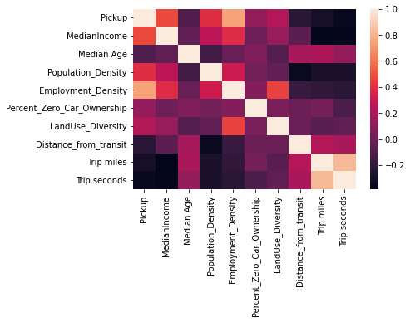
Output
Heatmap

Slide 17
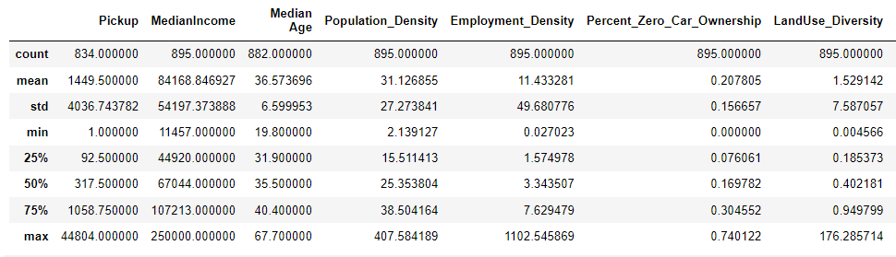
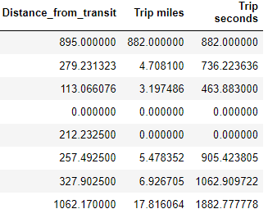
Output
Descriptive statistics for our dataset and heatmap

Slide 18
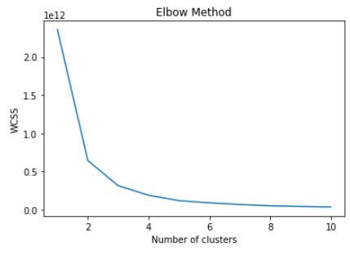
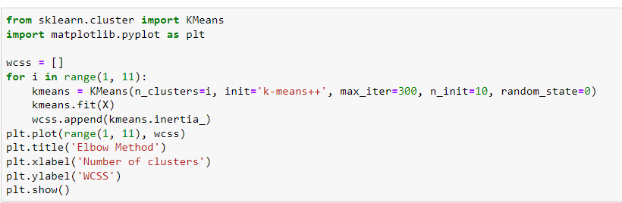
Output
Elbow analysis shows us that three clusters will be optimal

Slide 19
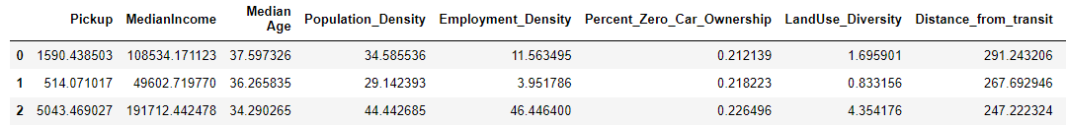
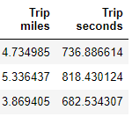
Output
There are three different kinds of census tracts:
There is the high income group consisting of people on average aged 34, median income 191k$, living close to transit who on average travel 3.86 miles, and where 22% don’t own cars.
There is the medium income group consisting of people on average aged 37, median income 108k$, living a bit further to transit who on average travel 4.7 miles, and where 21% don’t own cars.
1. There is the low income group consisting of people on average aged 36, median income 49k$, living close to transit who on average travel 5.36 miles, and where 21% don’t own cars.

Slide 20
EXPECTED OUTPUT
OUTPUT
We have clustered census tract data into three categories.
For Uber this means that any product they launch in the Chicago area has to be targeted to three different demographics.
IMPLICA-
TION

Slide 21
Future Roadmap
We need to work with the year’s data instead of just July.
We need to do cross-validation
3. We need to explore the relationship between distance to transit and pickups
4. We need to dig deeper into the relation between median income, employment density and pickups: does type of employment matter, white collar vs blue collar etc.

